Slide 2
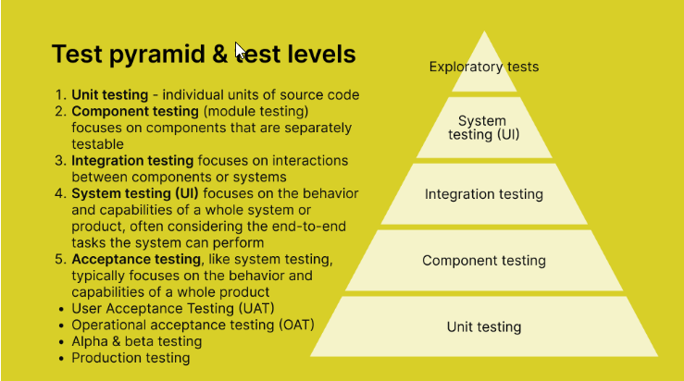

Slide 3
Both Incremental Model and RAD (Rapid Application Development) Model are iterative approaches to software development, but they have different characteristics and methodologies.
Incremental Model:
Methodology: It divides the software development process into smaller, more manageable increments or iterations.
Process: Each iteration goes through the phases of requirements, design, implementation, and testing. However, these phases are applied incrementally to different parts of the system rather than to the entire system at once.
Advantages: Provides faster initial delivery of software, allows for early testing and feedback, and accommodates changes more easily than traditional linear approaches.
Disadvantages: Can lead to integration issues if not managed properly, and may require careful planning to ensure that each increment adds value to the system.
RAD Model (Rapid Application Development):
Methodology: It emphasizes rapid prototyping and iterative development.
Process: RAD involves developing prototypes quickly based on user feedback and refining them through multiple iterations. It typically involves joint application development (JAD) sessions where developers and stakeholders collaborate closely.
Advantages: Accelerates the development process, fosters stakeholder involvement, and allows for early detection of issues.
Disadvantages: Requires a high level of user involvement, may not be suitable for large-scale projects, and can lead to a lack of documentation if not managed properly.

Slide 4
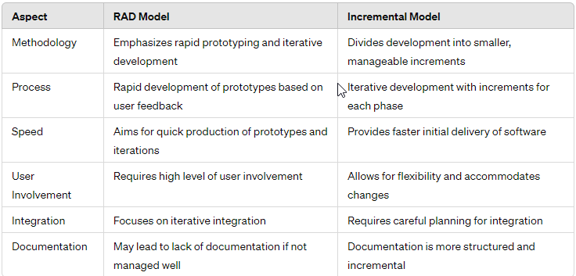
Difference between RAD Model and Incremental Model

Slide 5
Verification and validation are two critical processes in software development that ensure that the software meets quality standards and satisfies user requirements. Here's a breakdown of each:
Verification
Validation
Definition: Verification is the process of evaluating work products of a development phase to determine whether they meet the specified requirements for that phase. It aims to answer the question: "Are we building the product right?"
Key Activities:
Reviews: Conducting peer reviews, walkthroughs, and inspections to identify defects and ensure adherence to standards.
Testing: Executing various types of testing, such as unit testing, integration testing, and system testing, to verify that each component of the software functions correctly.
Analysis: Analyzing documents, designs, and code to ensure consistency, completeness, and correctness.
Purpose: To ensure that the software is being developed according to the requirements and standards set for each phase of the development lifecycle.
Definition: Validation is the process of evaluating the final product to determine whether it meets the user's needs and expectations. It answers the question: "Are we building the right product?"
Key Activities:
User Acceptance Testing (UAT): Involving end-users to test the software in a real-world environment to ensure it meets their requirements.
Requirements Validation: Ensuring that the software meets the specified requirements and addresses the user's needs.
Functional Validation: Checking if the software functions as intended and delivers the expected outcomes.
Purpose: To ensure that the software satisfies the intended purpose and delivers value to the users and stakeholders.

Slide 6
Desktop Applications Testing:
Desktop applications are software programs designed to run on a single computer or workstation. Testing desktop applications involves assessing their functionality, usability, and performance. Here's an overview:
Functionality Testing: Ensuring that all features and functions of the desktop application work as intended. This includes testing user interfaces, data processing, and business logic.
Compatibility Testing: Verifying that the desktop application is compatible with various operating systems, hardware configurations, and third-party software.
Usability Testing: Evaluating the user interface design, navigation, and overall user experience to ensure that the application is intuitive and easy to use.
Performance Testing: Assessing the speed, responsiveness, and stability of the desktop application under different load conditions.

Slide 7
Web Applications Testing:
Web applications are software programs accessed through web browsers over the internet. Testing web applications involves assessing their functionality, compatibility, security, and performance. Here's an overview:
Functionality Testing: Ensuring that all features and functions of the web application work correctly across different web browsers and platforms.
Compatibility Testing: Verifying that the web application is compatible with various web browsers, operating systems, and devices (desktops, laptops, tablets, and smartphones).
Security Testing: Assessing the security of the web application by identifying vulnerabilities such as cross-site scripting (XSS), SQL injection, and authentication flaws.
Performance Testing: Evaluating the speed, scalability, and reliability of the web application under different load conditions, including concurrent user traffic.

Slide 8
Mobile Applications Testing:
Mobile applications are software programs designed to run on mobile devices such as smartphones and tablets. Testing mobile applications involves assessing their functionality, usability, performance, and compatibility across different devices and platforms. Here's an overview:
Functionality Testing: Ensuring that all features and functions of the mobile application work correctly on different mobile devices and operating systems.
Usability Testing: Evaluating the user interface design, navigation, and overall user experience to ensure that the mobile application is intuitive and easy to use on small screens.
Compatibility Testing: Verifying that the mobile application is compatible with various mobile devices, screen sizes, resolutions, and operating system versions.
Performance Testing: Assessing the speed, responsiveness, and battery consumption of the mobile application under different network conditions and usage scenarios.

Slide 9
Decision Table Testing:
Definition: Decision table testing is a black-box testing technique used to test systems with a large number of possible input combinations. It helps identify different combinations of inputs and their corresponding actions or outcomes.
Usage: Decision tables are particularly useful when there are multiple conditions or rules governing the behavior of a system. Test cases are derived from combinations of inputs and expected outcomes based on these conditions.

Slide 10
State Transition Diagrams:
Definition: State transition diagrams, also known as state diagrams or finite state machines, represent the various states and transitions of a system or component. They illustrate how the system transitions from one state to another in response to events or inputs.
Usage: State transition diagrams are commonly used in software testing to design test cases that cover different sequences of states and transitions. Test cases are derived to verify the correctness of state transitions and behavior under different conditions.

Slide 11
Use Case Testing:
Definition: Use case testing is a black-box testing technique that focuses on validating the functionality of a system based on its use cases. Use cases represent interactions between actors (users) and the system to achieve specific goals.
Usage: Test cases are derived from use case specifications to ensure that the system behaves as expected for various user scenarios. Use case testing helps validate the system's behavior from an end-user perspective and ensures that it meets the requirements specified in the use cases.
Statement Coverage:
Definition: Statement coverage is a white-box testing technique that measures the percentage of executable statements in the code that have been executed during testing. It helps assess the completeness of testing by identifying code areas that have not been executed.
Usage: Test cases are designed to execute each statement in the code at least once. Statement coverage is calculated by dividing the number of executed statements by the total number of statements in the code, expressed as a percentage.

Slide 12
Path Coverage:
Definition: Path coverage is a white-box testing technique that measures the percentage of unique paths through the code that have been executed during testing. It helps assess the thoroughness of testing by identifying all possible execution paths.
Usage: Test cases are designed to traverse different paths through the code, including loops, conditional branches, and decision points. Path coverage is calculated by dividing the number of executed paths by the total number of possible paths through the code, expressed as a percentage.
LCSAJ (Linear Code Sequence and Jump) Testing:
Definition: LCSAJ testing is a white-box testing technique that focuses on testing sequences of code statements and jumps (e.g., loops, conditionals, and function calls) within a program. It helps ensure that all possible code sequences are executed and tested.
Usage: Test cases are designed to cover linear code sequences and jumps within the program, including all possible combinations of statements and jumps. LCSAJ testing aims to identify potential errors or defects in the control flow of the program.

Slide 13
Static Testing:
Static testing is a software testing technique that involves reviewing and analyzing software artifacts without executing the code. It is performed during the early stages of the software development lifecycle (SDLC) and focuses on finding defects and issues in the code, design, requirements, and other documentation.
Process:
Review Process: Static testing typically involves various review techniques such as code reviews, walkthroughs, inspections, and desk checks.
Focus on Quality: The primary goal of static testing is to improve the quality of software by identifying defects, inconsistencies, ambiguities, and violations of coding standards.
Early Detection: Static testing helps in detecting defects early in the development process when they are less expensive and easier to fix.
Benefits: It promotes collaboration among team members, ensures adherence to standards and best practices, and helps in knowledge sharing and learning within the team.
Dynamic Testing:
Dynamic testing is a software testing technique that involves executing the software and observing its behavior to verify its correctness and validate its functionality. It is performed during the later stages of the software development lifecycle (SDLC) and focuses on evaluating the software's performance, reliability, and conformance to requirements.
Process:
Execution Process: Dynamic testing involves running the software with test inputs and evaluating its outputs and behavior.
Test Techniques: Various dynamic testing techniques include unit testing, integration testing, system testing, regression testing, and acceptance testing.
Validation: Dynamic testing validates that the software behaves as expected and meets the specified requirements.
Error Detection: It helps in identifying defects, errors, and inconsistencies in the software's behavior, functionality, and performance.
Automation: Dynamic testing can be automated using testing frameworks and tools to increase efficiency and repeatability.

Slide 14
Globalization Testing: Globalization Testing is a type of software testing that is performed to ensure the system or software application can run in any cultural or local environment. In globalization, different aspects of the software application are tested to ensure that it supports every language and different attributes. For example, Facebook.com supports many of the languages and it can be accessed by people of different countries. Hence it is a globalized product.
Localization Testing: Localization Testing is a type of software testing that is performed to check system or software application for a specific geographical and cultural environment. Localized product only supports the specific kind of language and is usable only in specific region. For example, QQ.com supports only the Chinese language and can be accessed only by people of few countries. Hence it is a localized product.

Slide 15
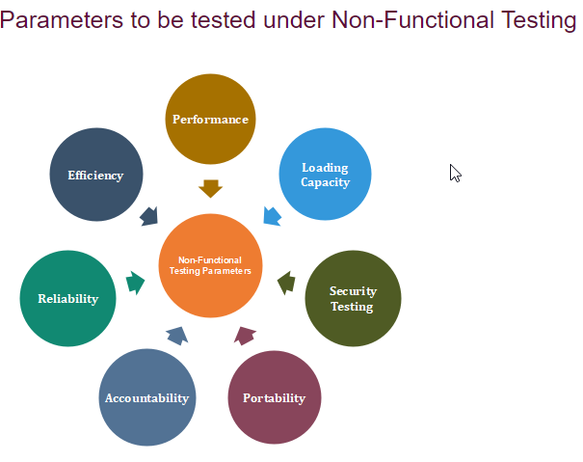

Slide 16
Data Migration Testing:
Data migration testing is a process of validating the successful transfer of data from one system to another. It ensures that data is accurately and securely migrated from the source system to the target system without loss, corruption, or inconsistency.
Data Conversion Testing:
Data conversion testing is a process of verifying the accuracy and integrity of data during the conversion from one format or structure to another. It ensures that data is transformed correctly according to predefined rules and requirements, maintaining its quality and usability in the new format or structure.

Slide 17
Security/Penetration Testing: Security testing involves evaluating the resilience of a system against potential cyber threats by simulating real-world attacks to uncover vulnerabilities and weaknesses.
Usability Testing: Usability testing assesses the ease of use and effectiveness of a software application by observing how users interact with it, aiming to identify usability issues and improve the overall user experience.
Install/Uninstall Testing: Install/uninstall testing verifies the smooth installation and removal of a software application, ensuring that the installation process is error-free and that the application can be cleanly uninstalled without leaving any residual files or registry entries.

Slide 18
Performance Testing: Assesses how well a software system performs under varying conditions, ensuring it meets speed, responsiveness, and scalability requirements.
Compatibility Testing: Verifies that a software application functions correctly across different environments, devices, and configurations, ensuring consistent behavior and user experience.

